Slide 1
Final Project WLOS Optimization
陳瀚坪 姜維 吳鎧帆

Slide 2
Outline
Architecture
SDRAM Controller
Firmware Code
DMA Transfer Data
Section Linker
Memory Mapping lds
Quick Sort (Insertion Sort)

Slide 3
Module Block
DMA
FIR, Matmul, Quick sort
SDRAM
WB Decode
DMA
WB-interface
WB-interface
WB-interface
WB-interface
WB-AXI
WB-AXI
WB-AXI
SDRAM Controller
AXI-Lite, AXI-S
AXI-Lite, AXI-S
AXI-Lite, AXI-S
Quick sort
Matmul
Verilo-FIR
SDRAM
tapRAM
(inference)
dataRAM
(inference)

Slide 4
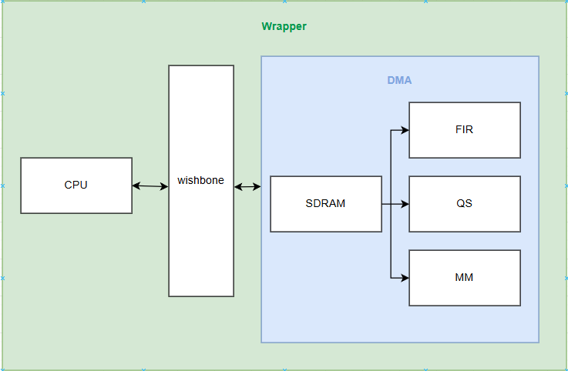
Architecture
Free CPU resource
Improve data transfer
Flow :
Init module input data
Start
dma transfer data from
SDRAM to Accelarator
CPU wait done

Slide 5
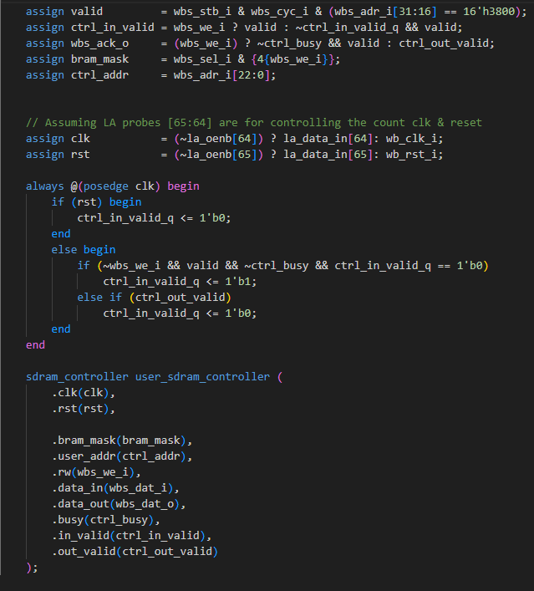
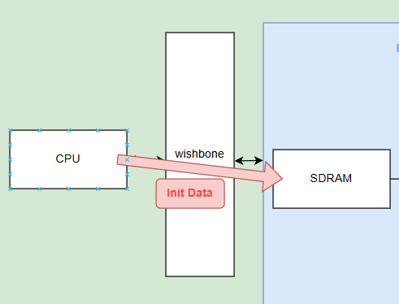
SDRAM Control
SDRAM for Wishbon port

Slide 6
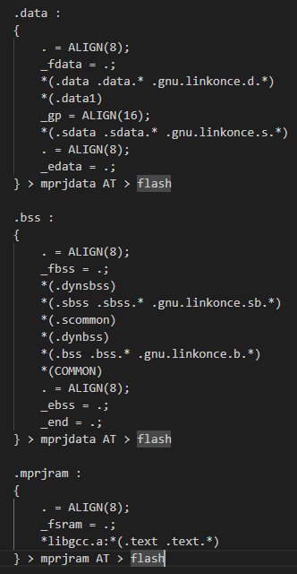
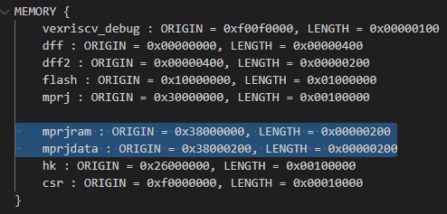
SDRAM Control
Memory mapping
Change code/data in different memory bank

Slide 7
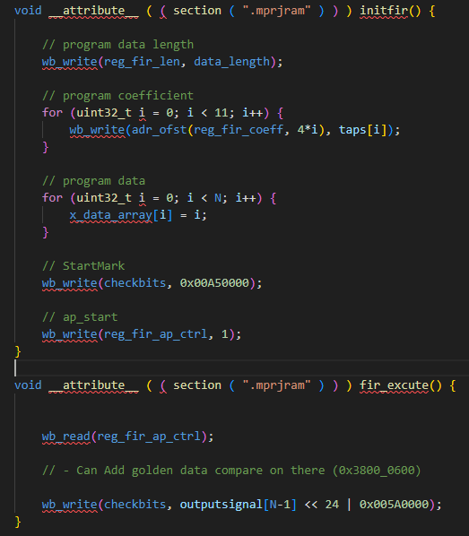
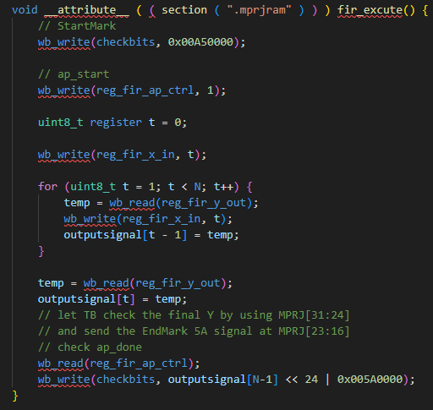
Firmware code
Change FIR transfer Input data method
Origin : Now :
Start change to init() to free CPU

Slide 8
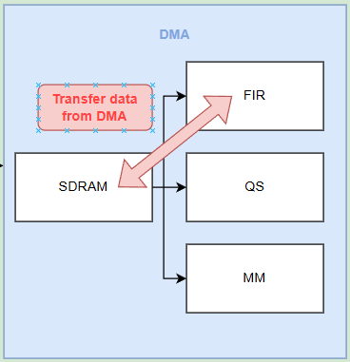
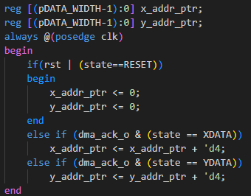
DMA Transfer Data
DMA
wait for 0x38000100 to start.
after start counter will plus 4 after ack
0x38000200 FIR Input
0x38000400 FIR Output

Slide 9
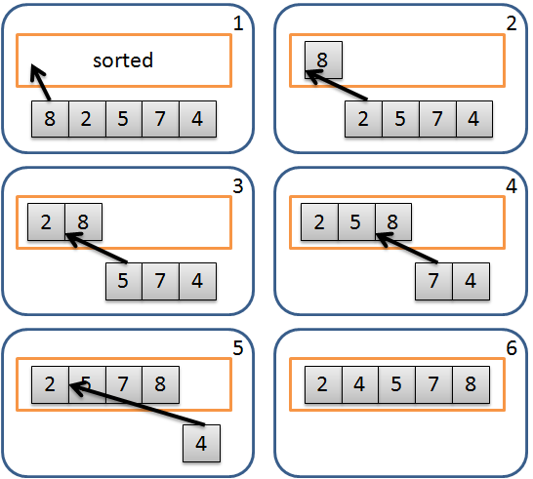
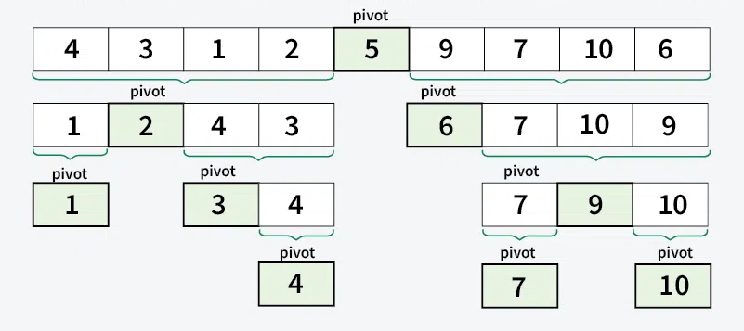
Quick Sort
Sorting Algorithm
  Quick sort
  Insertion Sort
Hardware Friendly
  Serial Input is more suitable for insertion sort

Slide 10
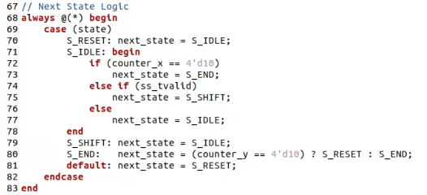
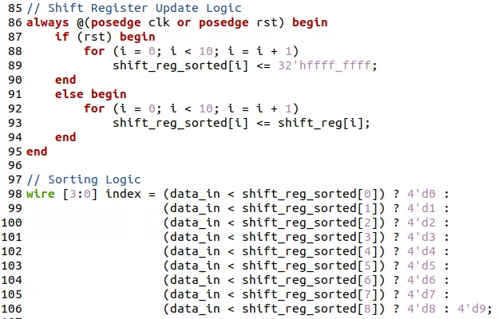
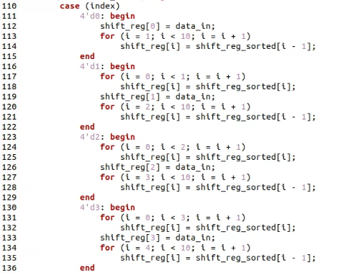
Quick Sort
FSM
Insertion Compare Logic
Sorted Data Logic

Slide 11
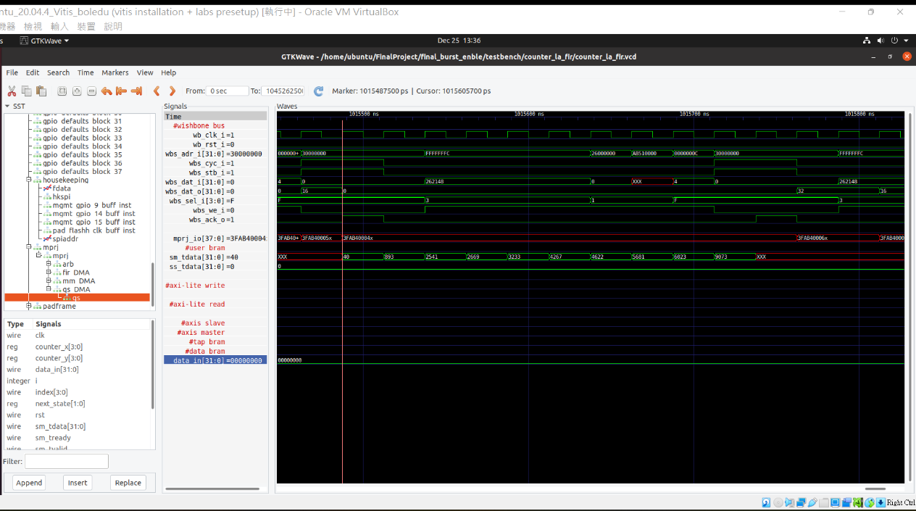
Quick Sort (Experiment)

Slide 12
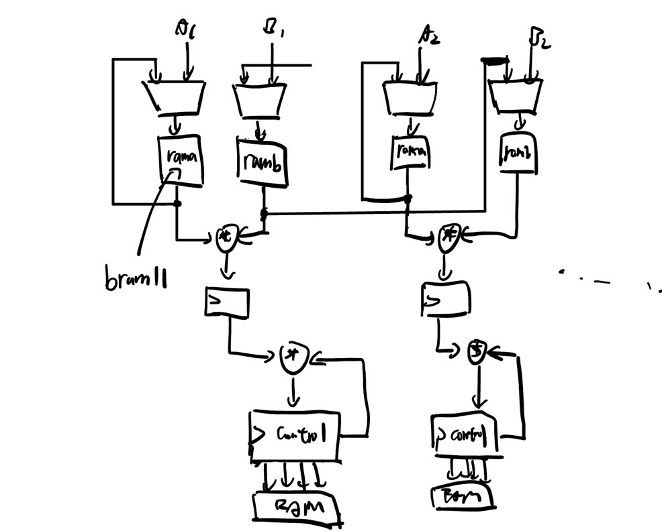
Matmul

Slide 13
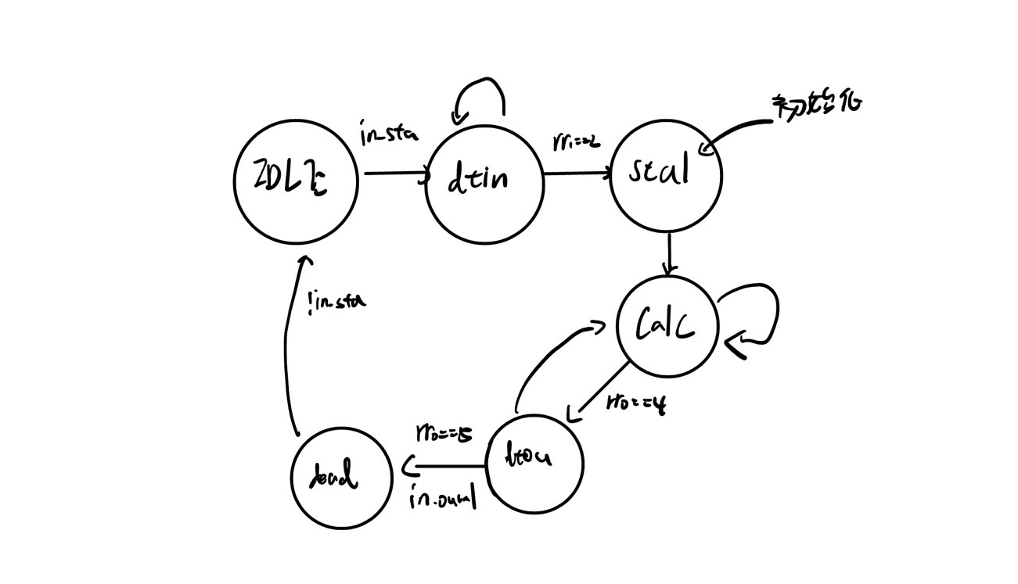
Matmul FSM

Slide 14
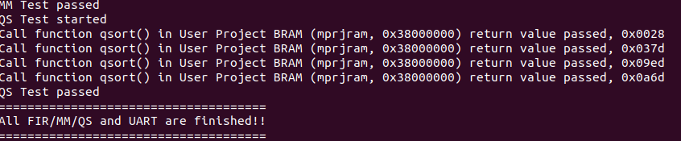
Matmul

